Slide 1
Controls and Interlocks
Doug Curry
USPAS, January 2017

Slide 2
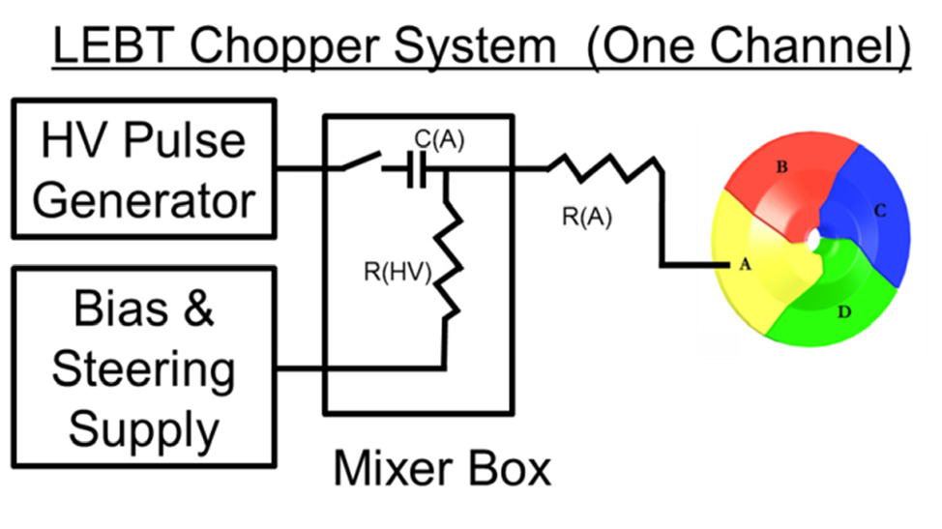
Terminating Beam
Methods for terminating beam in a Linac
Choppers
Faraday Cups
Shutters
Kickers
Terminate RF and Source gates
Pulsed Machine like SNS is easy to “steal” 7-10 cycles.
Single pulse configuration “for now”
STS is expected to change this
MPS Interface
Source
RF
RFQ
Ramping after a fault may be required > ms, seconds, minutes of beam off
This will be facility dependent

Slide 3
The “Machine Cycle”
60 Hz beam pulses
16.67ms defines 1 cycle
A Turn is dependent on beam energy
973 ns @ 850 MeV
911 ns @ 1.3 GeV
Cycle Start is t = 0
Ring Extract is t = 5050
Beam production stops at End of Inject, t = 5048
Beam is extracted from the Ring at 5050
Kick the beam out of the Ring
Beam size grows towards Cycle Start
Start of each machine cycle
Every 16.67 ms

Slide 4
The Machine Cycle
RF, source and diagnostic events
Beam On notifies subsystems, “this cycle is a beam cycle”
Power grid line synchronization was terminated after commissioning
Caused neutron smearing at the instruments because the Neutron Choppers couldn’t keep up with the load demands at the power plants
Not good for Neutron Choppers
Beam On Event
The Event Link is a biphase mark encoded bit stream that is derived to the ring clock.
This allows CDR (Clock and Data Recovery) circuits to create a local copy of the ring clock at the subsystem nodes

Slide 5
Beam Controls
Normal beam operations
“Beam On”
Operate source and RFQ during non-beam cycles
Maintain thermal stability
DO NOT generate beam
Blanking cycles
i.e. < 60 Hz
MPS “faulted” states
Shift gates in time
Pulsed machine
Kickers/shutters
CW machine
Source operates while the RFQ is active, beam is accelerated through the RFQ and into the Linac
Source shifted operations
”Beam Off”
End of Inject:
Timing Event that determines the “end” of an SNS Machine Cycle
Source operates almost 3 ms after the RFQ is active, beam is not accelerated and is lost in the RFQ structure

Slide 6
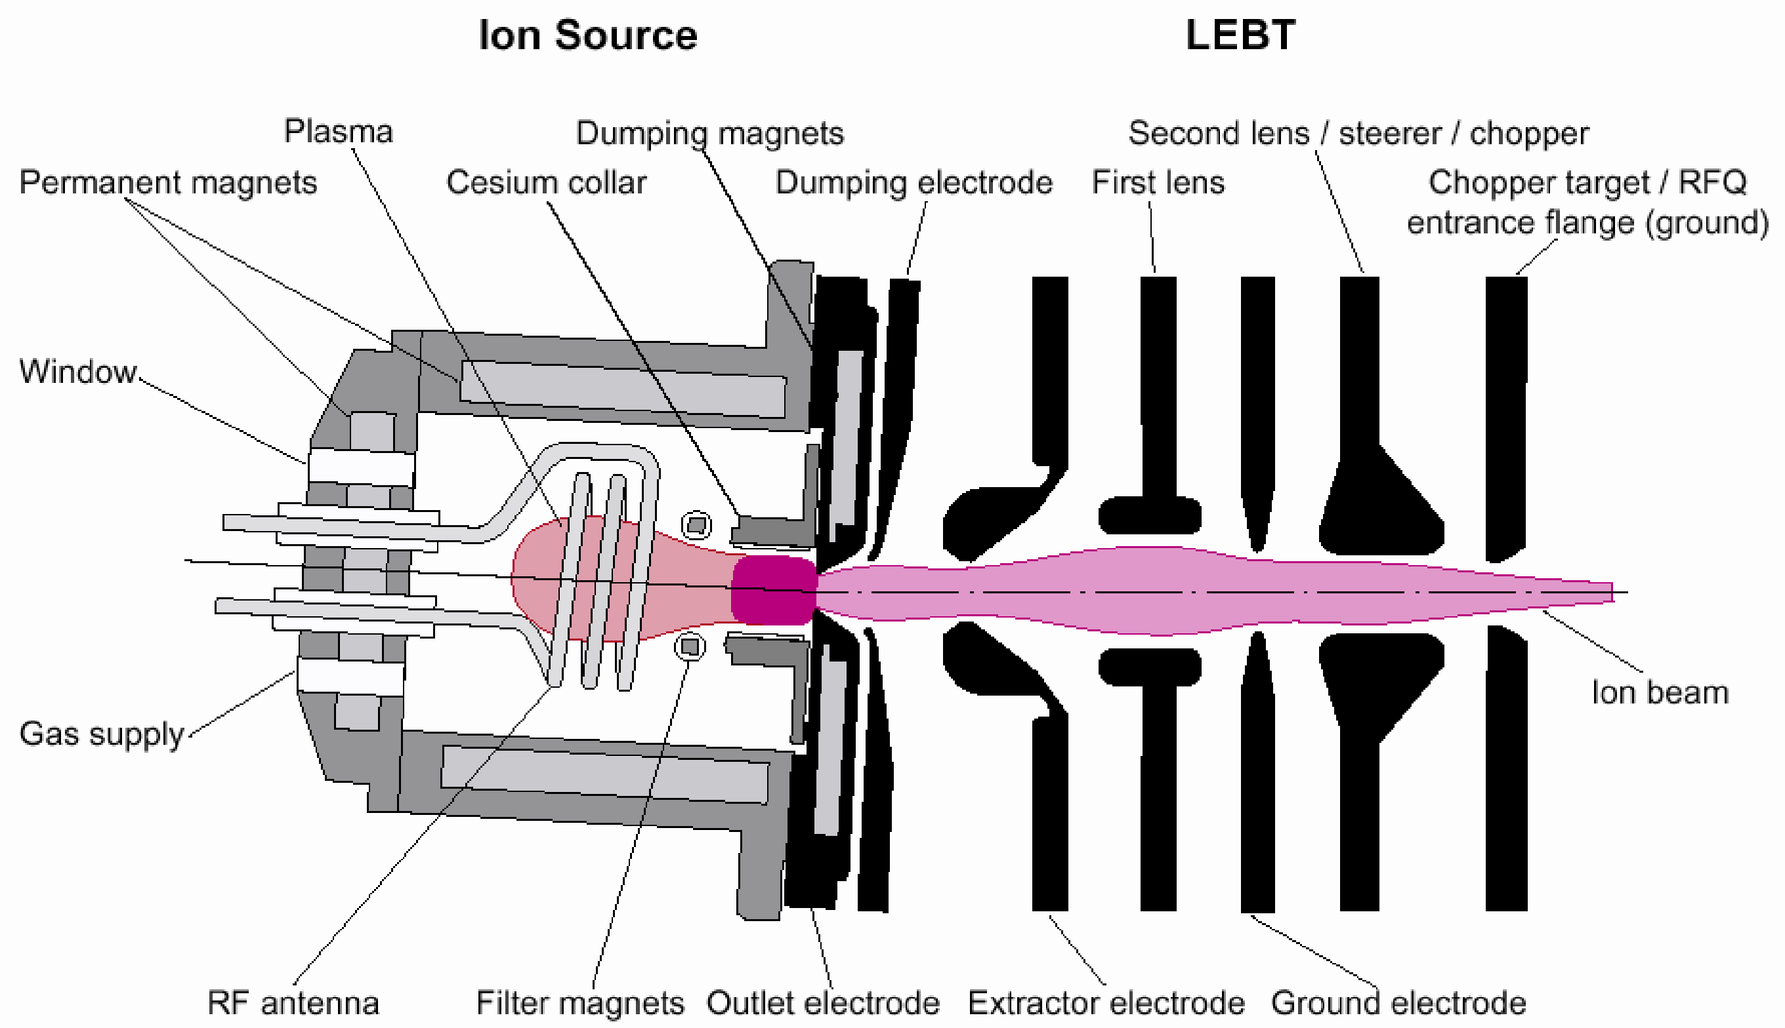
Beam Controls
DTL1 180° phase shift
Mitigate accelerating low leakage currents in the Linac, ~3 uA while the RFQ is on
Reduces heating in the SCL cavities
Eliminated in the 1st warm RF structure
Dark current seen using a view screen
~300 W 13MHz continuous RF generates a low power plasma
High beam current pulses are generated by a 50-70 kW 2MHz RF amplifier

Slide 7
Beam Controls
Set Chopper to ”full chop” during beam blanking cycles
Use the LEBT Chopper to “blank” out shifted Ion Source pulses, up to 20 Hz
>20 Hz increases the likelihood of damaging LEBT Chopper Target with increased heat load
Reduce contamination of the RFQ
High beam current pulses are generated by a 50-70 kW 2MHz RF amplifier
~300 W 13MHz continuous RF generates a low power plasma

Slide 8
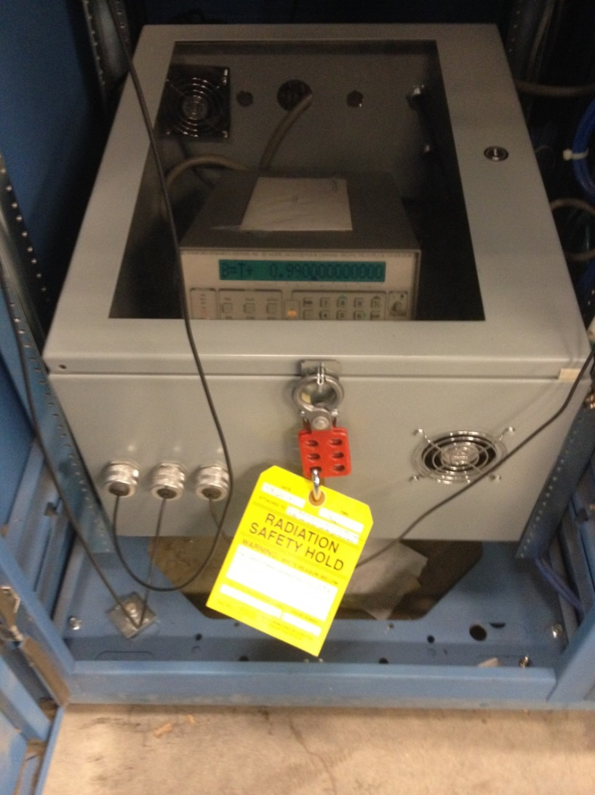
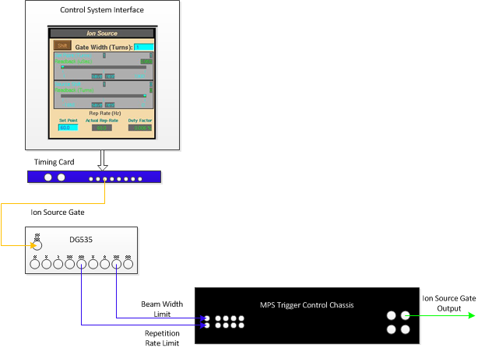
Protection by equipment lock-down
DG535
Rep rate
and
Pulse width
limits
Another method to limit beam pulse is to lock down certain control parameters
At SNS, the operators manually set a gate generator in the Front-end building to limit the possible source beam pulse length
The pulse can be < but not > than this setting, truncated by the DG535
Radiation Safety
RS-Hold

Slide 9
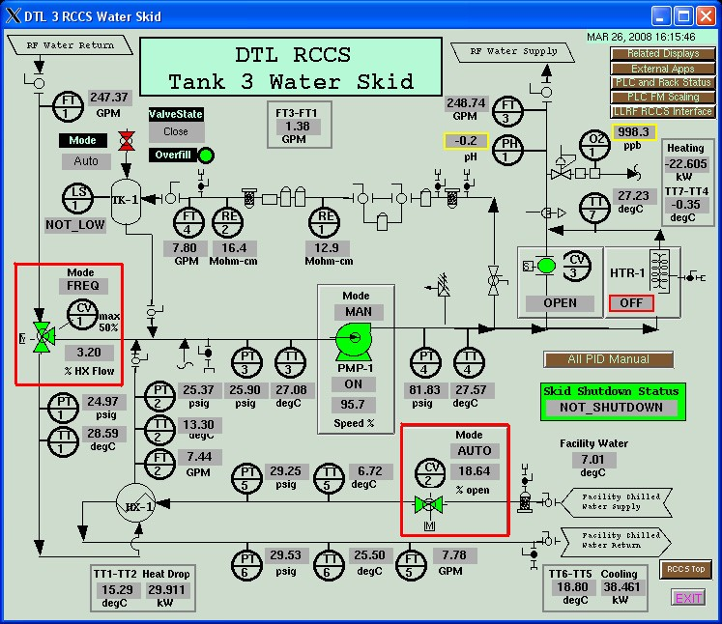
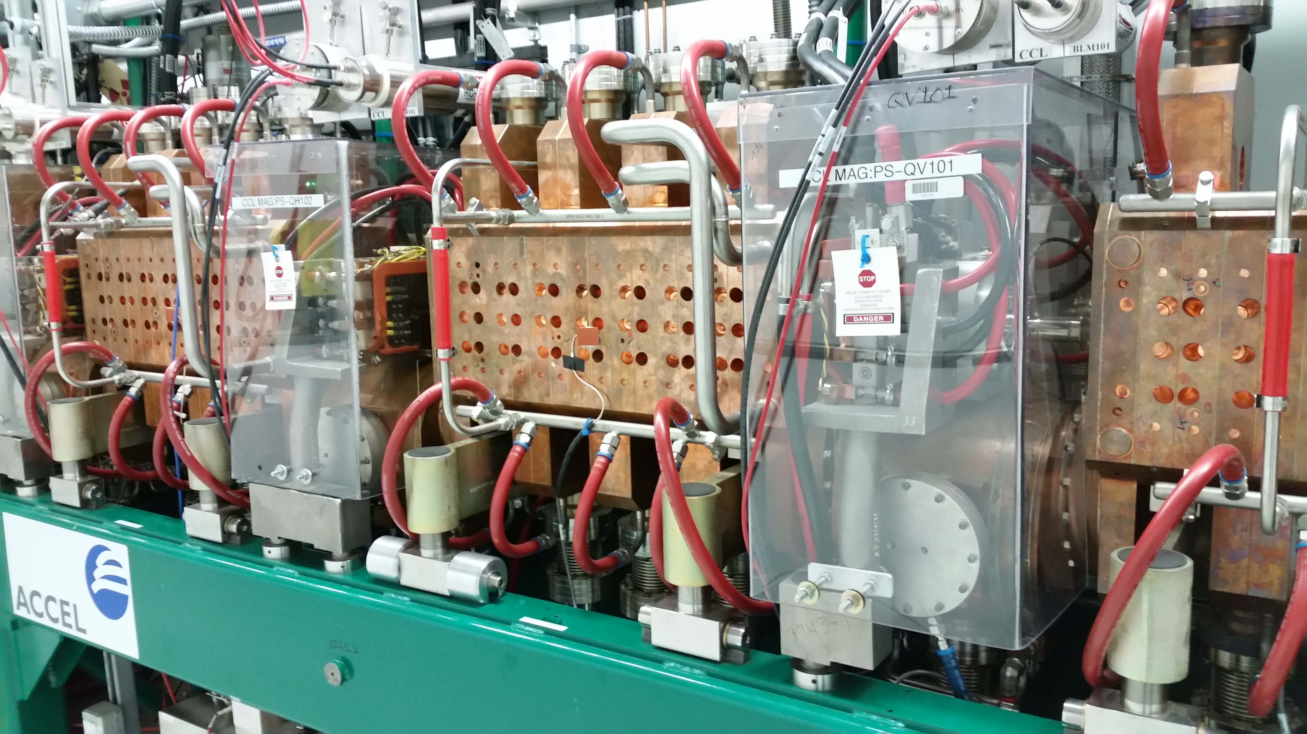
Beam Controls
Warm Linac Resonance Control Cooling System (RCCS)
Provide thermal stability for resonance control to reduce beam losses
10 system, one for each set of warm cavities
6 DTL
4 CCL
Hot and cold flow valves
SNS
CCLs

Slide 10
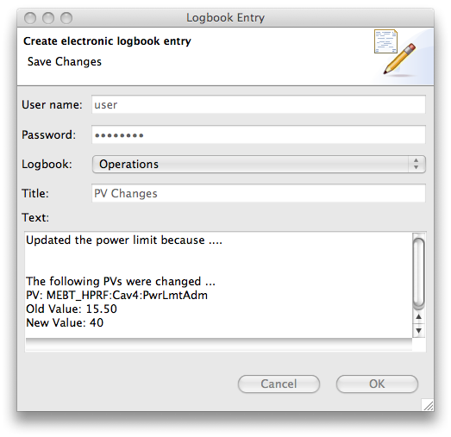
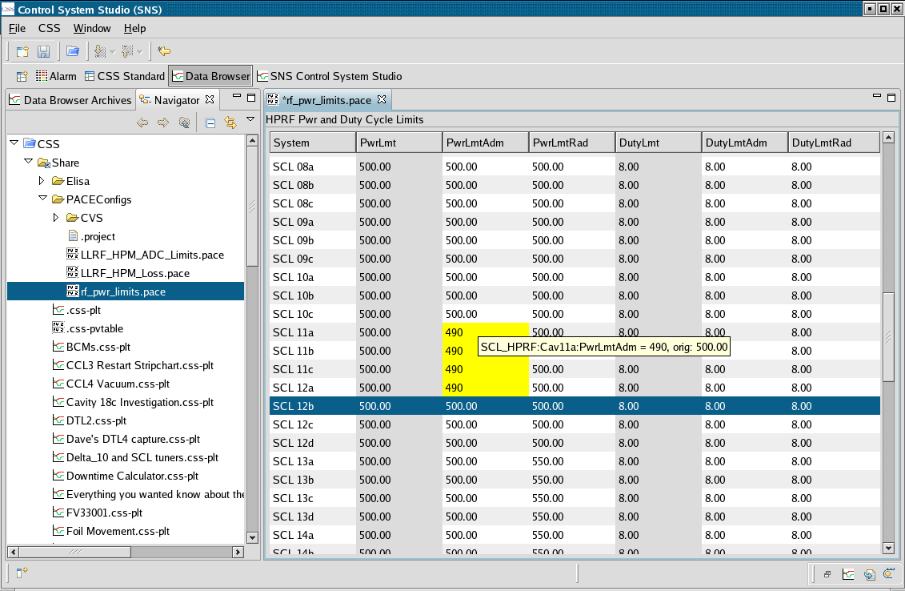
PACE
PACE (PV Adjust Confirm E-log)
EPICS (Experimental Physics and Industrial Control System)
Applied to critical control parameters
manual
automatic

Slide 11
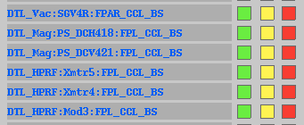
Configuration Control
Channel status
Device
Sector Gate Valve
Intended for 2 MW
SNS Beam Modes
50, 100, 1mS, Full Power, Off and Standby
SNS Machine Modes
MEBT BS, CCL BS, L-Dump, I-Dump, E-Dump and Target
Configured via MPS PLC
Located in the main Control Room
Read by the Timing Master and broadcast to each node at 60 Hz
Verified against database before every machine cycle
“Mode Mask” indication
Color is dependent on setting
Physical input status
from field device

Slide 12
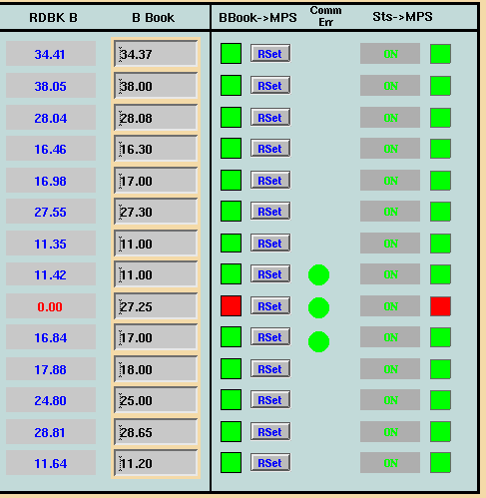
Software Interlocks
Magnets
Power Supplies
HV levels for BLMs
Power supply settings
Chatter Fault limits
Auto recovery → manual recovery
Dump Power limits
Combined with administrative controls
Injection Dump uses fast protect hardware “Nano-coulomb detector”
Soft interlocks are too slow in the event of a Primary Stripper foil failure

Slide 13
Protection by alarms
Control system can monitor many parameters, and alert operators when these parameters stray outside of pre-defined limits
These are separate from the automatic interlocks.
Alarms do not automatically turn off the beam.
Alarms may be set to alert operators before parameters reach the interlock limits, or may be set on some less rigorous parameters

Slide 14
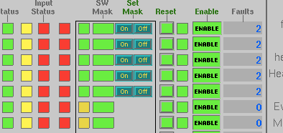
User Screens
Overview of
the SCL
Approximately 110 nodes at SNS
Without interface screens, it would extremely difficult to know which system reported the fault
Also allows operations to establish bypass settings
The input status
reflects faulted
Input channel
Bypass
Enable/disable
Fault
counters
The channel status
is green because
the Machine Mode is
upstream of this location

Slide 15
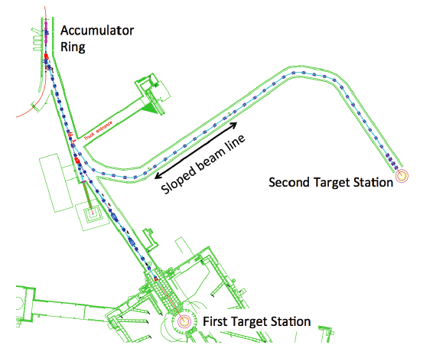
Moving forward STS
Extraction
Septum
Second Target Station (STS)
Single pulse configuration
Two pulse configuration for STS (Second Target Station)
STS 10-20 Hz
47 kJ per pulse
Kicker Magnet interface
Beam must go to STS
Kicker
Magnets
R2T2
Dipole
Example: What level of effort should be spent protecting the FTS beam when a fault occurs on the STS beamline?
A fault occurs in the R2T2 transport line or target. It is desirable to not disrupt beam to the FTS. This requires coordination between the Timing System and MPS to ensure only STS cycles are disrupted.

Slide 16
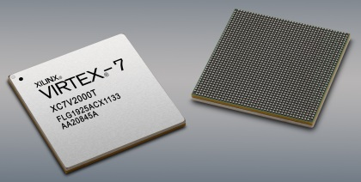
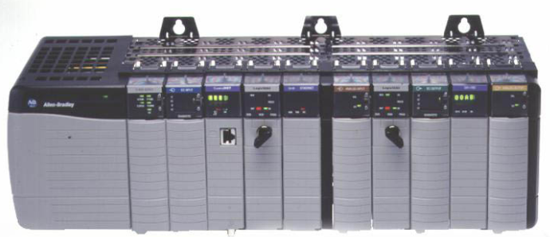
Implementing Interlocks
Microcontroller design
PLCs “Slow Interlocks,” milliseconds
Software “Soft Interlocks,” seconds
Discrete Components, microseconds
ICs
FPGAs
CPLDs
Varying levels of reliability
Failure methods plague all types
Discrete components
PLC
software
microseconds
milliseconds
seconds

Slide 17
The Magic FPGA
??????
FPGA
👿
😎
problem
solution
FPGA
(Field Programmable Gate Array)

Slide 18
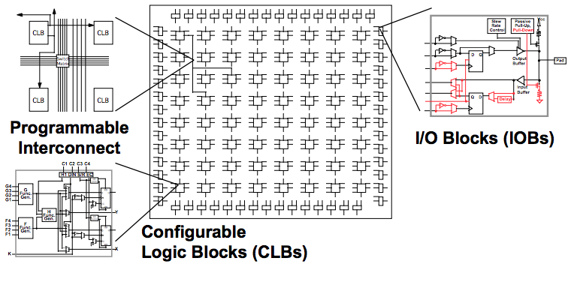
FPGA “basic” SRAM architecture
Logic Blocks
4 input LUT (look up table)
Programmable Interconnect
Routing configurable resources together
I/O pins
Configurable and fixed types
Internal RAM
External Flash
Device program storage
SRAM type, most common
Anti-fuse/Internal Flash, heavy in defense and aerospace
Basic Xilinx layout

Slide 19
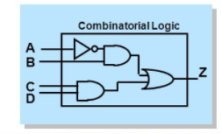
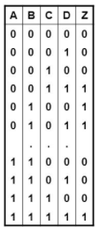
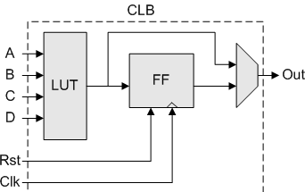
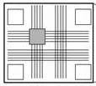
FPGA architecture
Size metrics
Flip Flops (registers, bit storage)
LUTs
RAM blocks
No Logic gates internally
Functions are translated via Look Up Tables
LUT
Look up table
DFF (D-type Flip Flop)
Mux
Entire resource is consumed if any of its elements are used
**This is no longer true in modern day devices
Interconnect
Xilinx simplistic view of LUT configuration

Slide 20
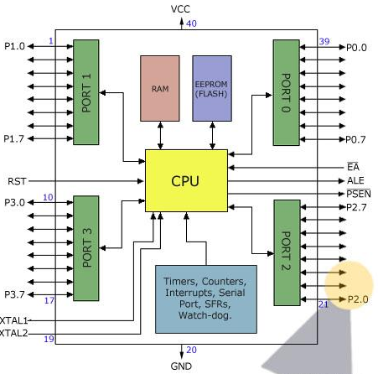
Microcontroller “basic” architecture
CPU
Central Processing Unit
Shared bus(es)
RAM and Flash
Boot-up Instruction storage
Program storage
External I/O
Instruction/Data Cache
Other interfaces
Intel and PowerPC
Atmel AT89S52

Slide 21
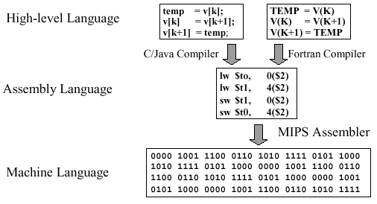
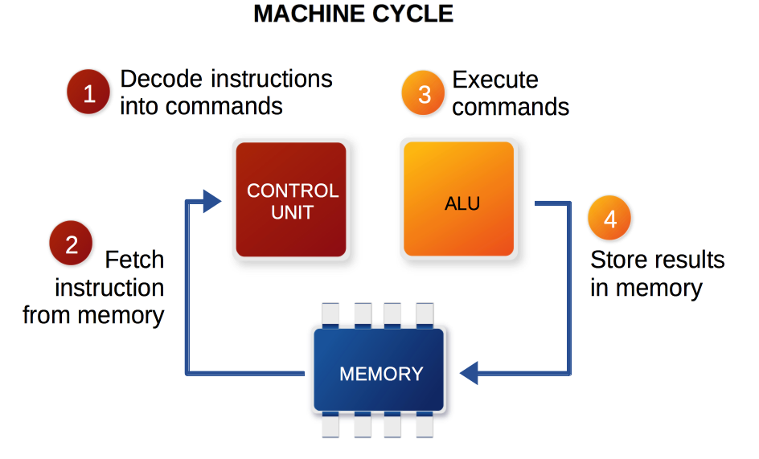
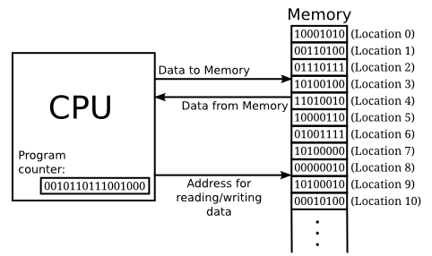
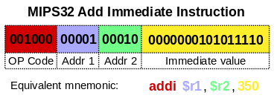
Basic CPU Example
1GHz clock
Perform 1 step per clock cycle
Intel
“Execute commands” occur at 250 MHz!!!
Add the immediate value to the value stored in address location 2 and store that result in address location 1

Slide 22
Basic Similarities
Flash to store programs
uC typically local, FPGA typically external
On Power up, programming functions are loaded
Clocking resources (synchronous devices)
User Configurable, one to many times, flash dependent not device dependent
Susceptible to ”event upsets”
SEU, MEU, … several classifications depending on the failure type
Radiation hardened devices
Level of ”hardening” varies significantly
Modern day devices are highly complex architectures

Slide 23
Basic Differences
Microcontroller
FPGA
Single process execution (time slicing)
GHz clocking speeds
Dynamic program configuration
Operating Systems
Broad user community
Plethora of programming languages
Compile and go…
Massive Parallel Processing
MHz clocking speeds
Fixed program configuration
Direct programming
Limited user community
Concurrent programming languages
Timing constraints, PLL configuration, …

Slide 24
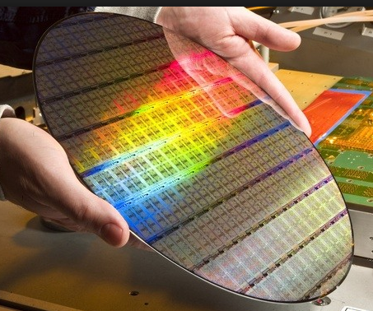
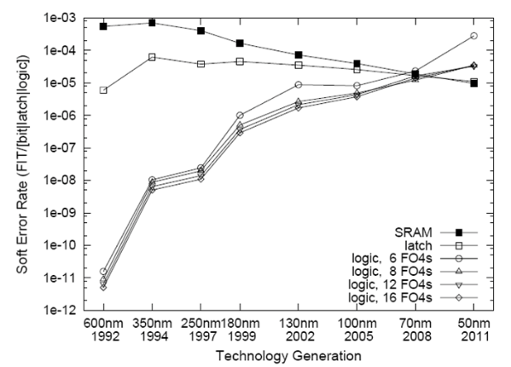
Single Event Upset (SEU)
SEU, MEU (Multi)
SEFI – Single Event Functional Interrupt
Can be repairable in real-time, depending on location and device
SEL – Single Event Latch Up
Fixed by power cycling the device
SEB – Single Event Burnout
Permanent damage, non-repairable
SER
Soft Error Rate
*2017*
14 nm
Moor’s Law
Transistors double per unit area every 2 years

Slide 25
Error detection
SReg
FSM (Finite State Machine)
Encode “one-hot”
Run the State Register through an XOR gate
CRC (Cyclic Redundancy Check)
CRC “Sum” is transmitted with data
TMR (Triple Modular Redundancy)
Can be implemented internal to an FPGA
Multiple devices feeding a PLC
Etc…
XOR
Output will always be ‘1’
Single bit error detection method
M
What if the failure occurs in the voting scheme?
V
M
M
TMR
CRC

Slide 26
CPU SEU Example
ADDI “Add Immediate” becomes ANDI ”logical AND Immediate”
Could have just as easily occurred to either of the address or value registers
What if this was a branch or jump command?
New instruction
Expected instruction
001100
Could be any of these!!!!

Slide 27
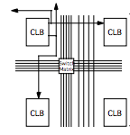
FPGA SEU Example
x
x
0
Programmable switch matrix
Utilize CRC capabilities of programmable devices
Usually requires partial to full reconfiguration of the device
This can be an automated process
For Interlocks, it will likely be better to notify and take no immediate action

Slide 28
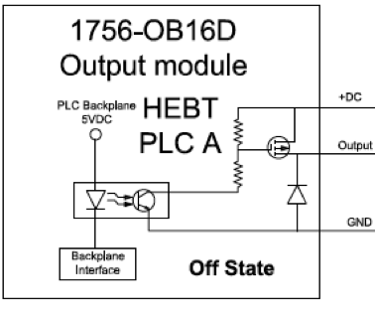
Other failure modes
Stuck at ‘1’/‘0’ (high/low)
Doubled Digital I/O as SNS for PLC interfaces (SA1) ”MPS Good”
SNS Vacuum Interface
Electrical overload during maintenance created permanent damage to the output gate
Gated Clock “MPS Good”
SNS MPS Hardware failure
Firmware doesn’t match final design requirements
Does your organization consider firmware software or hardware?
Are firmware changes subject to DCN (Design Change Notification) process?
What if it’s part of an interlock system???
SA’1’
Backplane interface

Slide 29
Accelerator PPS Grounding Error
April 2013 - Modification to add redundant power supplies to increase availability
Inter-segment handshaking not tested as part of installation QA or post modification tests
Error found July 31, 2013 during annual certification testing
Under certain conditions, PPS would not have shut off the front end for a downstream fault
Common mode error affected both of the redundant chains
Unintended result of modification to PPS systems to add redundant power supplies
Beam Operations halted until mitigating measures in place
It took 9 days before receiving a letter of resumption from DOE
Failure mode identified and replicated on bench
Very complicated failure mode

Slide 30
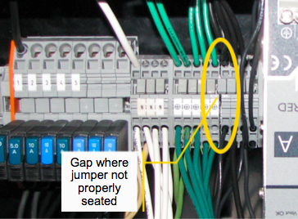
Accelerator PPS Grounding Error
Power supply modification required a common ground between A and B divisions
Improperly installed jumper "floated" Linac PPS ground, creating a sneak circuit
Sneak circuit defeated segment to segment handshaking if enough PLC outputs were ON

Slide 31
Biased input “good condition”
Inputs
Biased ON

Slide 32
Sneak Circuit – Outputs Bias Inputs

Slide 33
Machine Protection and Operation
Doug Curry
USPAS, January 2017

Slide 34
From Commissioning to Operations
FTS
STS

Slide 35
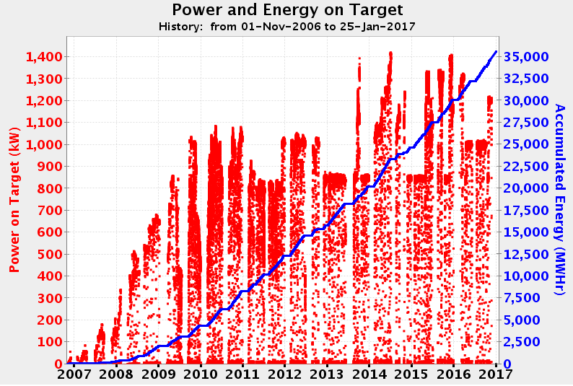
From Commissioning to Operations
1.4 MW
~ 7 years
> 1.3 MW
1.2 MW Run Period
1.0 MW Run Period

Slide 36
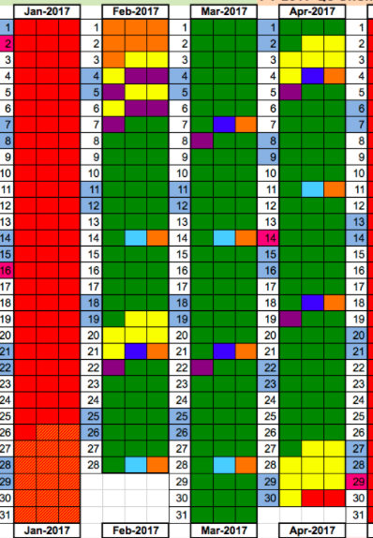
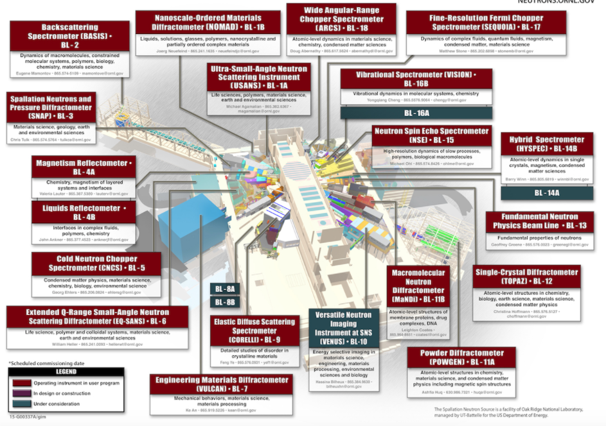
Machine availability
Disruption to the user program
Especially for short duration experiments
DOE expectation of their facilities
Categorize failures depending on experimental impacts
4 hours?
12 hours?
1 day??
Anticipate 1 week delay in machine startup
SNS Instrument layout

Slide 37
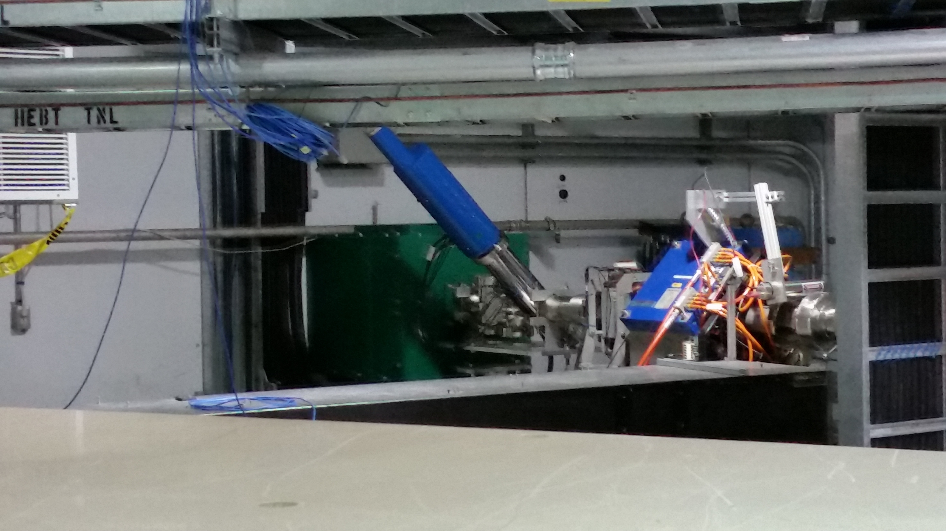
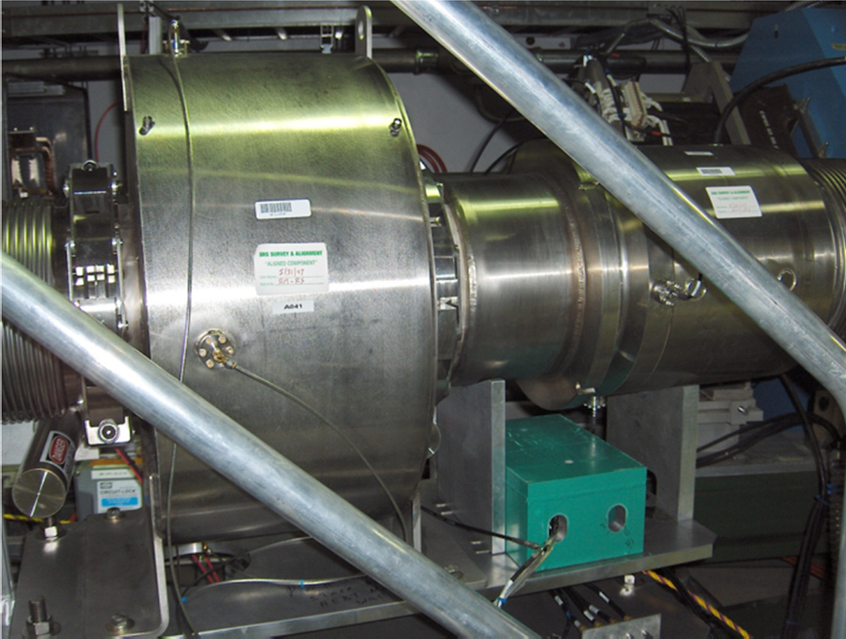
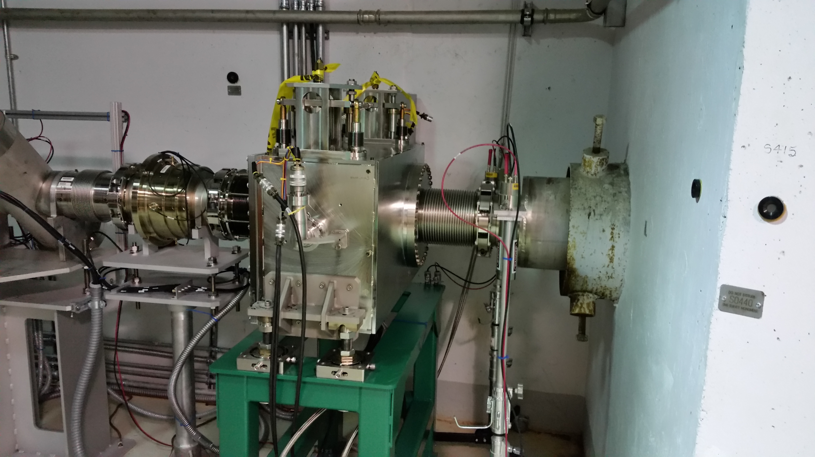
MPS Installations
Administration failure
highly unlikely
Cost/performance
Component cost versus MPS hardware costs
Commissioning to full production period
Risk
Likelihood of occurrence
Machine availability
Time to recover machine
Time to recover beam
No NCD at the Linac Dump
X
NCD and supporting hardware
$$$ - €€€
Foil Failure
Highly likely
✓
NCD installed at the
Extraction Dump

Slide 38
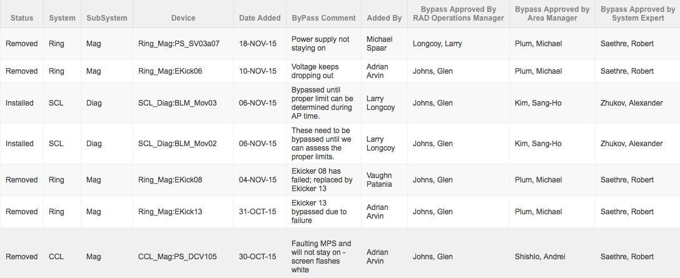
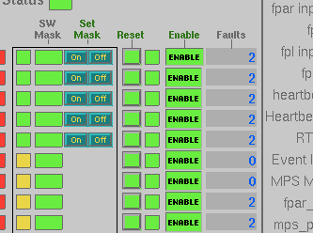
Masking interlocks
3 approvals required
3 level to approve an MPS bypass request
Some MPS interlocks bypasses must be enabled local at the hardware
Bypass log
Masking enabled
Masking disabled at the MPS hardware
MPS Screen

Slide 39
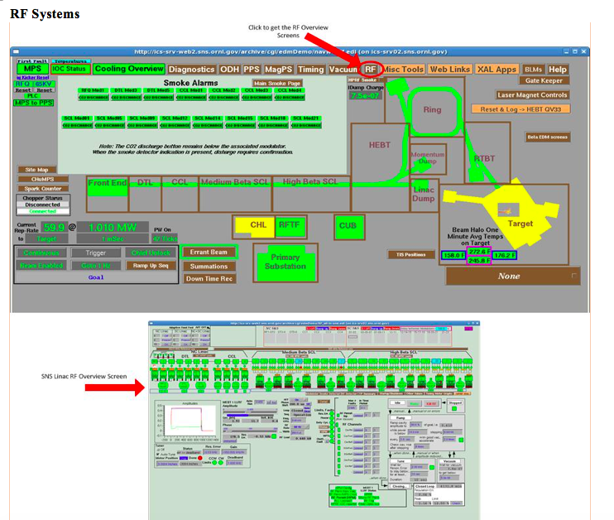
Administrative
MPS Interlock checks
SNS documented procedure
Completed at the end of every extended outage (2x/year)
Increasing to 3x per year
Fault each device locally one at a time to verify the integrity of the system
Takes about 1 week effort of combined time to go through all of the systems
> 1000 inputs
MPS ”fiber” link light measurements are performed every extended outage

Slide 40
Operational disruptions
> 8 hour downtime example
Software Interlocks wouldn’t work due to incorrect readbacks from power supply
Root cause
Contributing causes

Slide 41
Operating Metrics
Production hours, what we were supposed to do
Accelerator physics, what we actually did do
Production hours, what we actually did do
% availability during production period
% availability during accelerator physics
Accelerator physics, what we actually did do
Totals

Slide 42
Operating Metrics
Meeting is held weekly to discuss machine performance
Unscheduled downtime for the week, overview
Systems showing signs of degradation are discussed

Slide 43
Operating Metrics
Unscheduled downtime for the week, detailed

Slide 44
Operating Metrics
Current FY summary of downtime per group

Slide 45
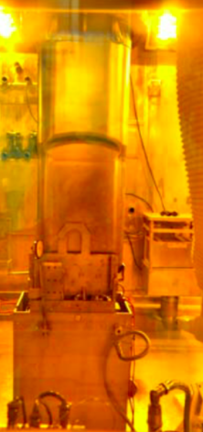
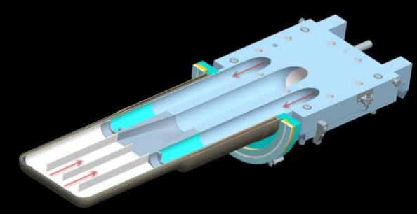
Sustaining Operations
Moving to 3 target changes per year to prevent disrupting the user program
Original expectations were 2 targets/year
Hg Channels

Slide 46
Sustaining Operations
Gas injection system online early FY18

